Slide 1

Varendra University
Dept. of Computer Science & Engineering (CSE)
Lab 9
Course Title: Microprocessor and Assembly Language Lab
Course No: CSE 334
Prepared By:
Md. Adnan Sami
Lecturer, Dept. of CSE, VU

Slide 2
Experiment Date: May 20, 2025
Experiment No: 09
Name of the Experiment:
Write some code in assembly language for shift operation using EMU8086.
Write some code in assembly language for rotate operation using EMU8086.

Slide 3
Experiment Date: May 20, 2025
Experiment No: 09
Name of the Experiment: Implement a program in EMU8086 that uses shift or bitwise operations to check if a number is even or odd.

Slide 4
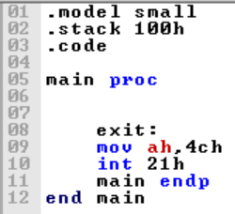
Return

Slide 5
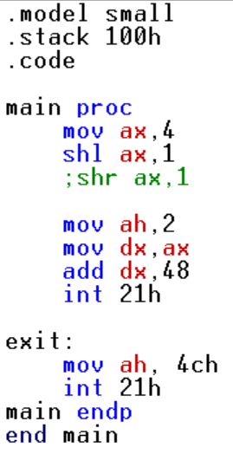
Write some code in assembly language for shift operation using EMU8086.

Slide 6
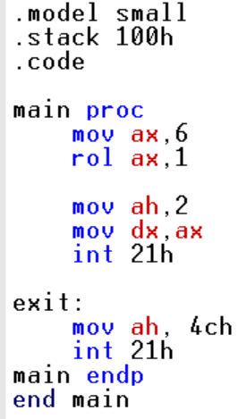
2. Write some code in assembly language for rotate operation using EMU8086.
Notes:
s

